Slide 1
Categorizing the content of GitHub README Files
A project for ENSF-612, Fall-2021
Presented by
Bhavyai Gupta, Kayode Awe, and Michael Man Yin Lee
6-December-2021

Slide 2
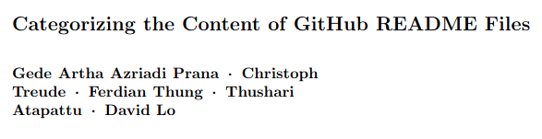
Problem Overview
The Future of GITHUB?
Notes:
README.MD are one of the most important documentation for open-source repositories where it is the first point of communication between the owner of the code to its users. Doing it poorly would mean that it would be very difficult for the community to learn about the open source code and use it.
However, many people, myself included, are often lost to the huge sea of opensource code and often don’t know where to start. Not only that, there haven’t been a well defined standard that developers follow to create the Readme file, which makes it very hard for people to easily gauge what these repositories are exactly for.
And that is why this research existed, which is to solve and improve the readability of these readme files by using machine learning to effectively predict and label well defined and standardized categories within the Readme files based on its context.
As mentioned from the research paper itself, the participants or the users who tested the labelling functionality based on machine learning classifications have reported increase effectiveness in information discovery.
We believe that the machine learning done with this research can help evolve the Github ecosystem to be more user-friendly and more accessible by improving easier information discovery on the vast treasures of source code that can be found within the world of Github.

Slide 3
Project Summary
Based on research paper “Categorizing the content of GitHub README Files”
We will explore
How was data collected?
How does our new manually annotated data compare?
How is the data preprocessed?
How does the model performed?
How does the model change based on hyperparameter choices?
Misclassifications

Slide 4
Collection of new data.
Developed "readme_downloader.py"
It downloads README.md files from GitHub using GitHub API
Files downloaded are randomly chosen but unique
Files downloaded belong only to the Software Development repository and have size greater than 2 KB.

Slide 5
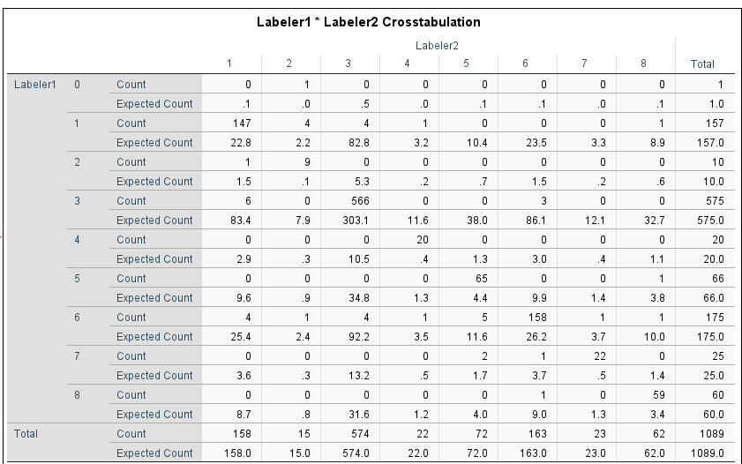
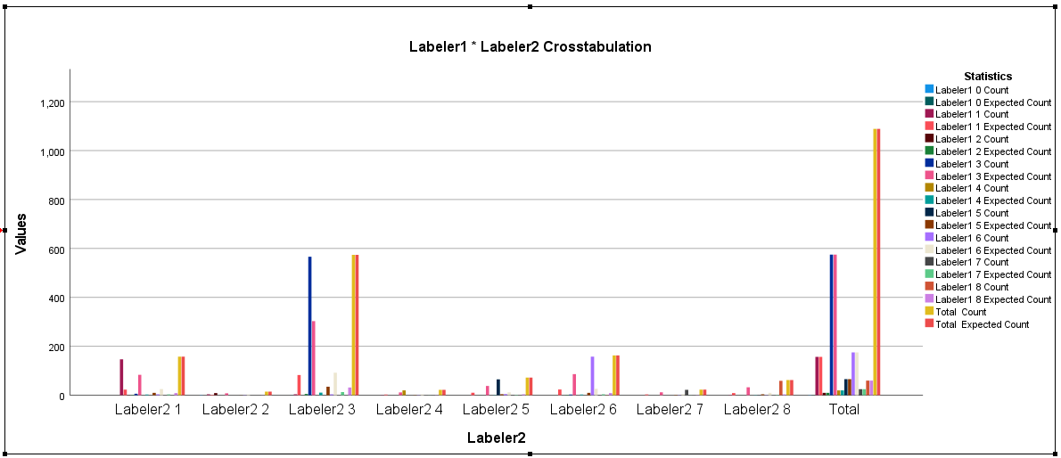
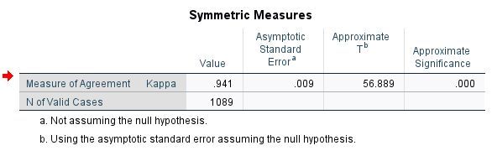
Agreement Analysis for the manually labelled data
Manual annotation was carried out 1089 sections of the new data
Cohen Kappa analysis was used to perform agreement analysis
The analysis return kappa of .945 (94% agreement).
Crosstabulation is shown between two labelers.
Disagreement were result by revisiting the sections using majority votes

Slide 6
Comparison of the new data with the original
The original dataset comprises of 393 Github README files containing 4226 sections.
The new files consist of 1089 README file sections.
One common trends between both sets of data is the fact that the “how” section account for over 50% count.
Similar distribution of sections across the two set of data.

Slide 7
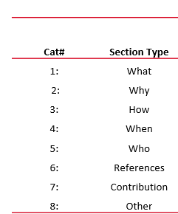
How the new files compare with the original.

Slide 8
Comparison of the original file with the new.
The numbers shown represent the different categories of the README file sections

Slide 9
Pre-processing of data
Content Abstraction – abstraction of content like code, numbers, images, links to their types
Tokenization and Stop Word removal using TfidfVectorizer
Encoding the classifications using MultiLabelBinarizer

Slide 10
Features Extraction
Statistical feature extraction
TF-IDF matrix generated from the abstracted, tokenized, stop-word removed content of the readme section.
Heuristic feature extraction
55 binary heuristic features derived from the headings and content separately.

Slide 11
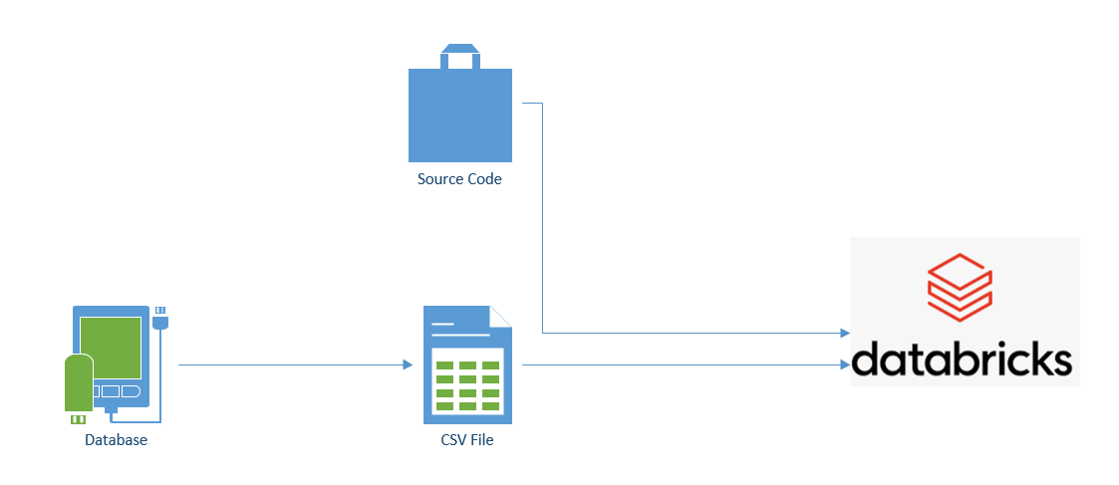
Model Preparation (DataBricks Conversion)
Notes:
The author of GitHub README Content Classifier has provided the source code for their classifier program on Github and As part of the requirements of the ENSF612 project, one of the first task is to convert the author’s program to be able to operate on Databricks.
Now, There are two hurdles that we need to overcome in order for us to successfully run their code on Databricks and they are:
1. The current program utilizes a sql database to store and process information.
2. Databricks runs on notebooks that makes referencing python module files from their FileStore difficult.
After investigating as to how the program works, we have determined to modify their experiment_classifier_validation.py script to meet our needs. We copy all of the code from this file into a new file called project_execution.py to make changes.
To address the first point, we dump their sql query data needed within the experiment_classifier_validation.py to do validation into a csv file.
This csv file is then uploaded to the Filestore in databricks.
To address the second point, we need to look at what files did experiment_classifier_validation.py so that we can consolidate the code into one file. Upon looking at the file, we observed that there are two files from which experiment_classifier_validation.py gets reference from and they are the heuristic2 and balancer files.
We then look at the code from those files and copy and re-organize the code so that everything can be running from a single class. The resulting code is what you see in the Databrick Notebooks that are linked in the final report.

Slide 12
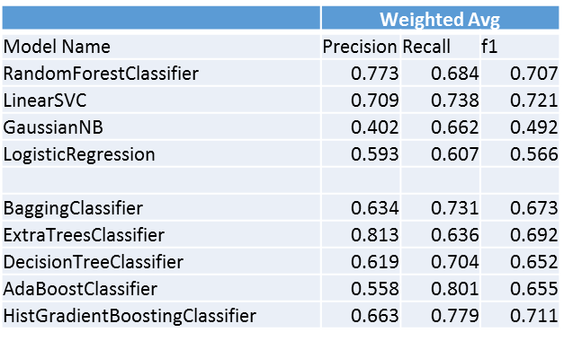
How do the models perform on the original data vs the new + original data?
Note: F1 = 2*(Precision*Recall)/(Precision + Recall)
Notes:
Following the general process that I have discussed in my previous slide, let us now talk about How do the models perform on the original data vs the new + original data?
With the original data, we have performed model analysis of the weighted average of precision, recall and f1 score for the models that you see in the left most column of the table showing in front of you right now.
The first four models, namely RandomForestClassifier, LinearSVC, GaussianNB and LogisticRegression were used in the original paper.
The last five models, BaggingClassifier, ExtraTreesClassifier, DecisionTreeClassifier, AdaBoostClassifier and HistGradientBoostingClassifier are models that have not been experimented by the original paper. Note that initially the original GradientBoost model is used but Databricks terminated the cluster before the model can finish running. HistGradientBoostingClassifier is also significantly longer to complete than the other models (took 5 hours compared to 2.35hrs for RandomForest and 11.5 minutes for LinearSVC), but it can successfully complete with the scores calculated.
As can be seen from the previous table, ExtraTrees classifier has the highest precision whereas AdaBoostClassifier has the highest Recall.
Recall that Precision = (True Positive/Total Predicted Positive) and Recall = (True Positive)/(Total Actual Positive), Extra Trees Classifier is the best model to use when the cost of any false positive is high and AdaBoost should be used if we want to filter out the most false negatives.
Now, for overall performance we should instead look at what we call the f1 score, which is a function of Precision and Recall where the formula is:
F1 = 2*(Precision*Recall)/(Precision + Recall)
From the table, the top 3 models that have the highest weighted average f1 score are: LinearSVC (f1 score = 0.721), RandomForestClassifier (f1 score = 0.707) and HistGradientBoost (f1 score = 0.711).

Slide 13
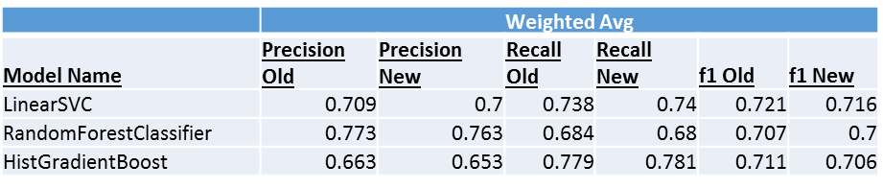
How do the models perform on the original data vs the new + original data?
Notes:
For the new combined data, due to additional processing time required for the addition of the new dataset, we only perform validation on the top 3 models with the highest f1 score.
As can be seen, the Precision, Recall and f1 scores drop slightly when additional data are added, but they do not affect the order of the performance ranking of these models.

Slide 14
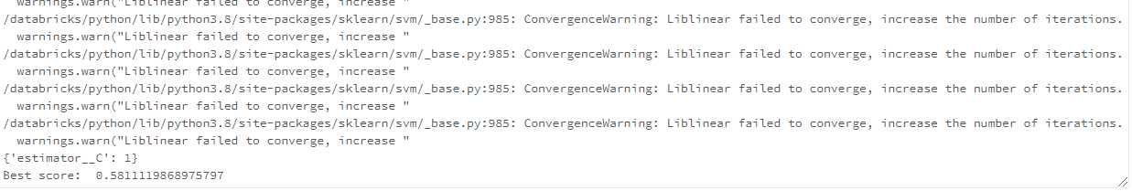
How does the performance of the models change based on the choice of hyper parameters?
Notes:
Attempts have been made to explore the hyperparameters for the project. We first explore the performance of the LinearSVC model based on the choice of hyper parameters. With LinearSVC, we explored the regularization parameter, or the C parameter of the model. We explored the effects on the model when parameter C is set to 0.001, 1, 100 and 10000.
However, it seems like only the default C value (1) can be successfully completed as the other C values fails to converge:
We have also try to explore grid search with other models such as the random forest classifier, but the code terminates on the databricks cluster before any results are produced.
We will run gridsearch again using sparkML once we have the code running without errors.

Slide 15
Misclassifications by the model
Selected random 200 misclassifications
Example 1: section getting labelled as Introduction/Project background
Example 2: section getting labelled as References/API Documentation

Slide 16
Key findings from misclassifications
Sections often get labelled as 1 (Introduction) whenever explanation is given for some feature, process, etc.
Presence of links can potentially bias towards section getting classified as 6 (References)
Section 3 (How) get labelled as Section 6 (References) as their differences can sometimes be narrow

Slide 17


Discussion
=
Notes:
One useful scenario that may be useful for real-life application of this model is that it can be used to gauge the effectiveness of the Readme files. For example, in the world of internet marketing, we gauge the effectiveness of copywriting by its ability to sale their products or what they call the conversion rate. Similarly, we can adopt this method by linking our model with statistics such as the number of stars in the repository or visitor stats to see what kind of information, if included in their readmes, will increase people to visit, branch or star the repositories, therefore giving information to developers as to what information they should include in their readme files to maximize the effectiveness and increase popularity of their repository.

Slide 18
Thank you for listening !
Notes:
To summarize, we have found that the LinearSVC that is initially chosen by the original authors is already the most optimized model for the work that is needed. And this concludes our presentation. Thank you for listening.

